Slide 1
Project HCICollector – Visualizing NetApp HCI Performance
Using Grafana, Docker, Trident, and Graphite
Aaron Patten
Virtualization Architect - Principle HCI TME
June 2018

Slide 2
Agenda
Quick Overview
Architecture
Installation
What’s in the Box
Collateral

Slide 3
HCICollector
What is it?
An open source, container based data acquisition and graphing project for NetApp HCI systems
Quick way to get ‘sore thumb’ data from an HCI system
On-premises augmentation of AIQ

Slide 4


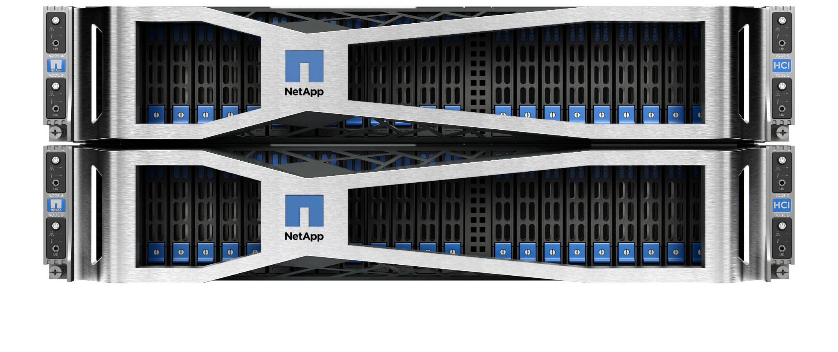




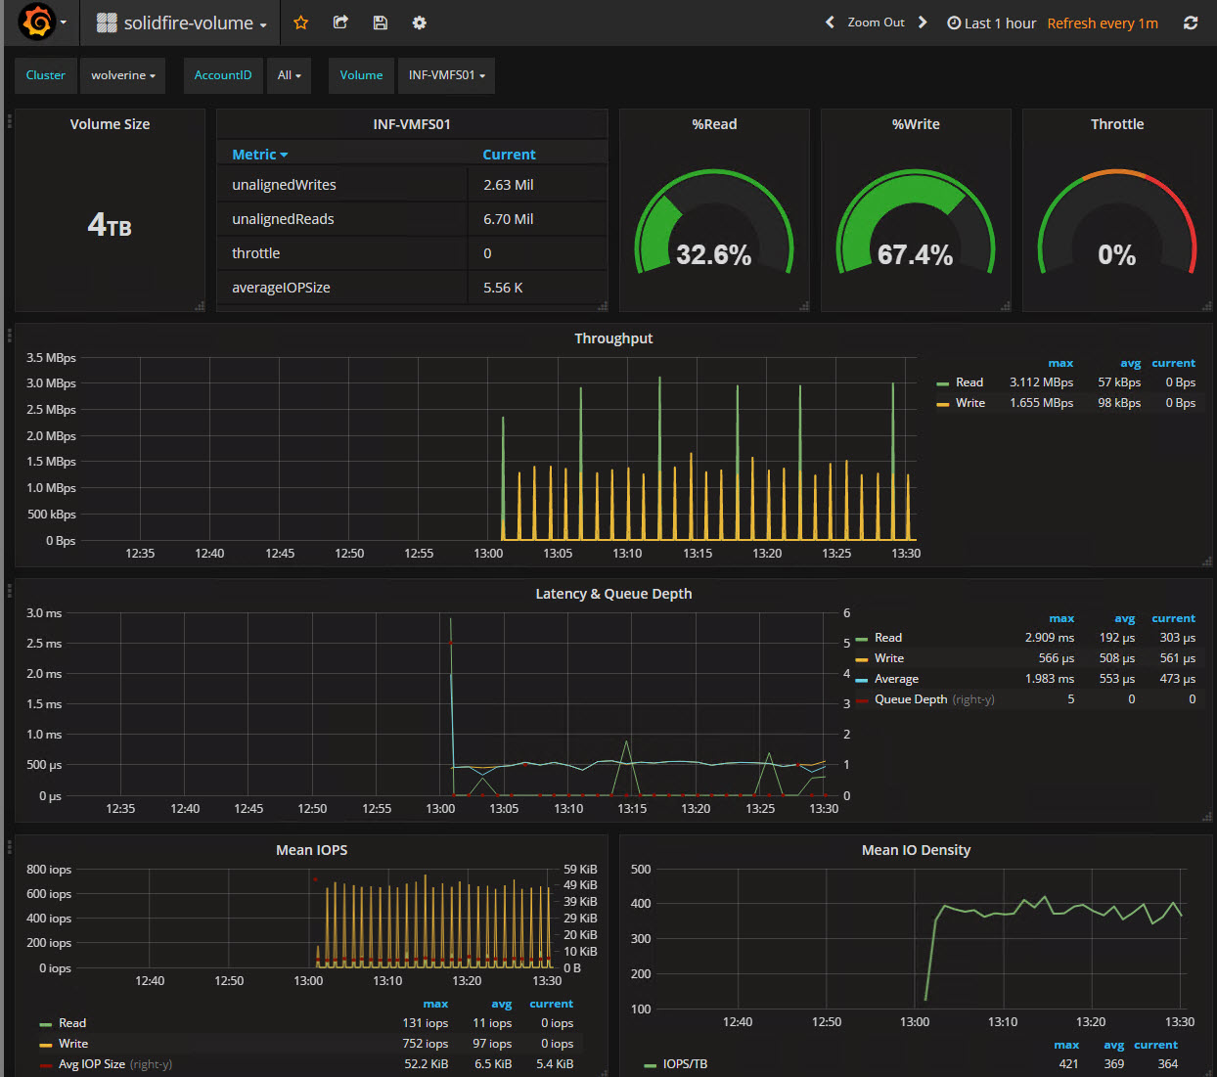

HCICollector Architecture
SolidFire/HCI Cluster
API Calls
HTTPS Port 443
SFCollector
Carbon Receiver
Port 2003
graphite-db
iSCSI – Trident
Port 3260
VMwCollector
SolidFire Volume
HTTP Alt
Port 8080
Grafana Dashboards
Port 80:3000

Slide 5
HCICollector Architecture
SolidFire/HCI Cluster
API Calls
HTTPS Port 443
SFCollector
Carbon Receiver
Port 2003
graphite-db
iSCSI – Trident
Port 3260
VMwCollector
SolidFire Volume
HTTP Alt
Port 8080
Grafana Dashboards
Port 80:3000

Slide 6
HCICollector
Installation

Slide 7
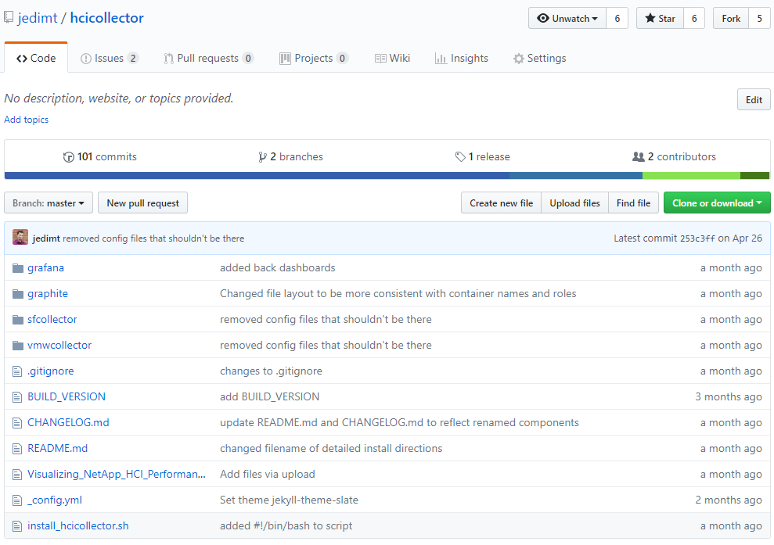
Installation
Where to get it?
Github of course!
https://github.com/jedimt/hcicollector

Slide 8
Installation
Prerequisites
Existing Docker host/VM
docker-compose
DNS records for components
vCenter
Hostname
FQDN
Username and password
SolidFire
Management virtual IP (MVIP)
Storage virtual IP (SVIP)
Username and password
Optional components
Trident for Docker plugin
Multipathing
Local volumes

Slide 9
Installation
High Level Steps
Clone the Github repo
Run install_hcicollector.sh script
Provide information
Start the HCICollector

Slide 10
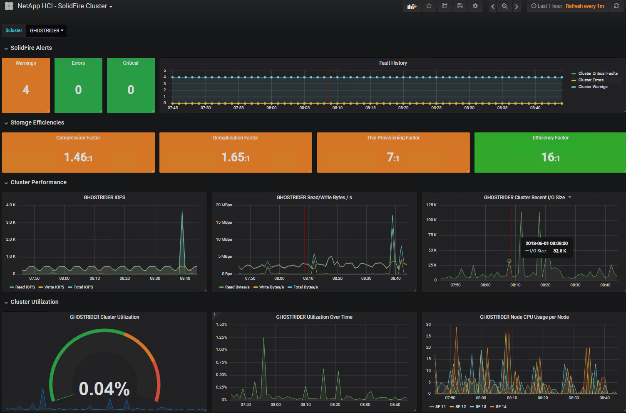
Installation
The Finished Product

Slide 11
HCICollector
What’s in the Box?

Slide 12
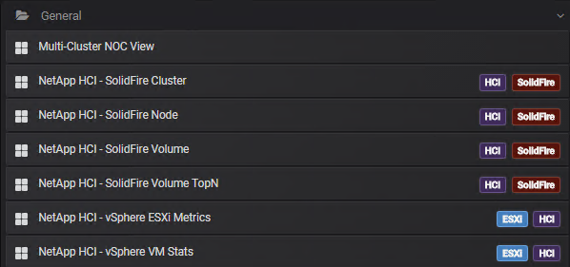
What’s in the Box
Preconfigured Dashboards
Seven preconfigured dashboards
multicluster-noc-view.json
solidfire-volume.json
vsphere-vm-stats.json
solidfire-cluster.json
solidfire-volume-topn.json
solidfire-node.json
vsphere-esxi-metrics.json

Slide 13
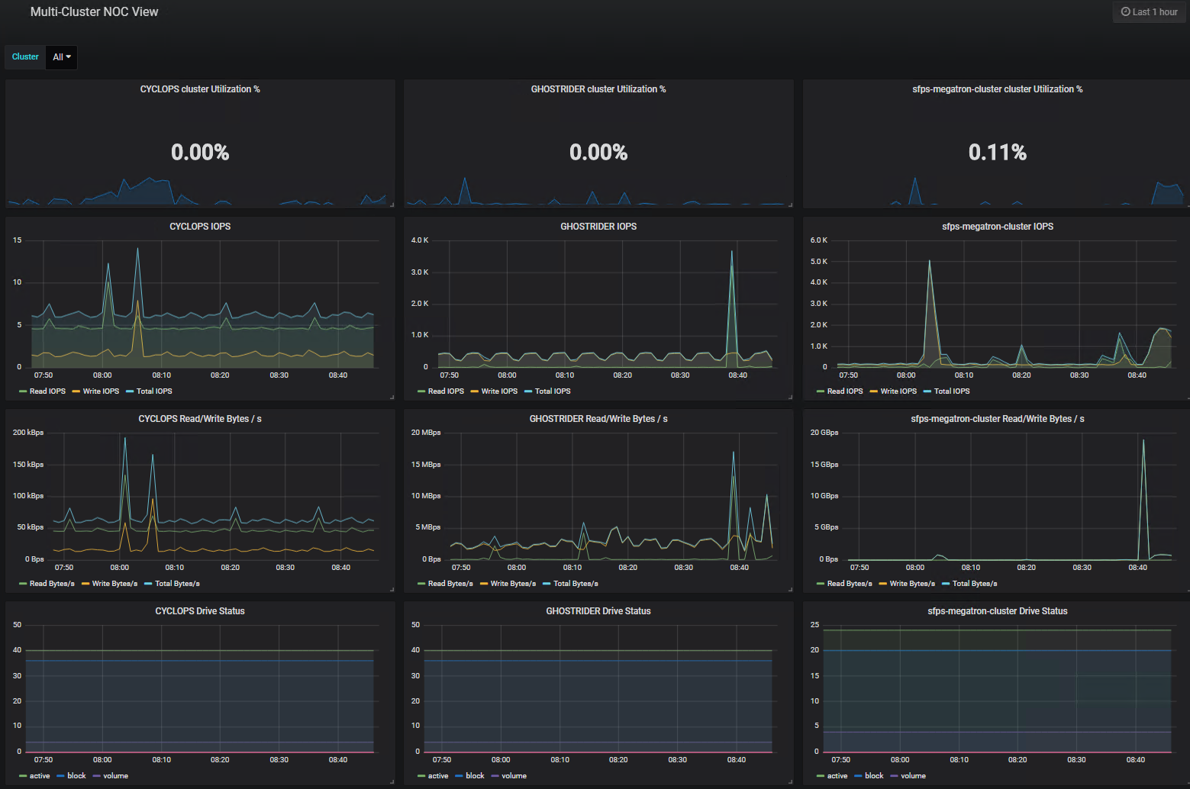
Dashboards
Multi-Cluster NOC View
High level multi-cluster view
Useful for monitoring high level stats for multiple systems

Slide 14
Dashboards
NetApp HCI – SolidFire Cluster
Overview of storage cluster stats
Alert count
Efficiencies
I/O counters
Cluster/node CPU Utilization
Sessions
Drive status

Slide 15
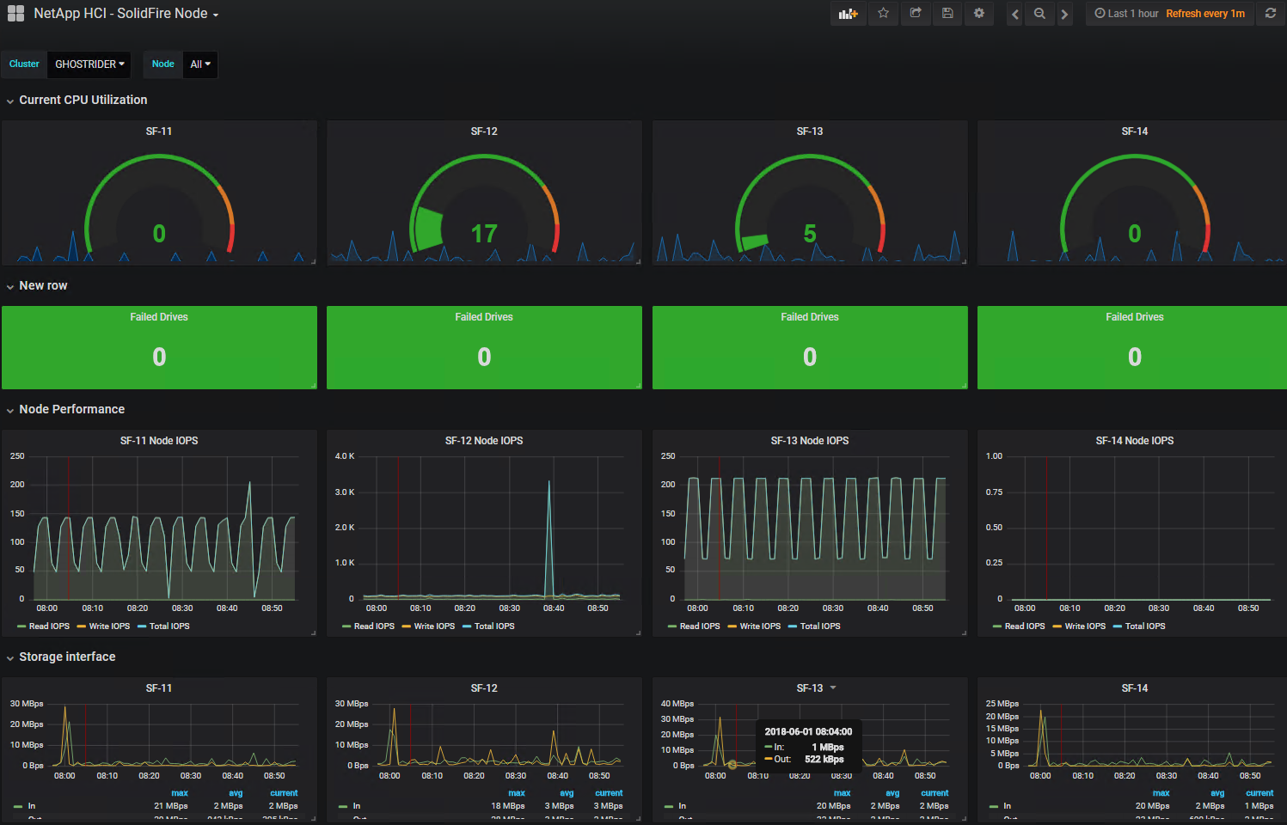
Dashboards
NetApp HCI – SolidFire Node
Overview of SolidFire nodes
CPU utilization
Failed drive count
IOPS
Network bandwidth

Slide 16
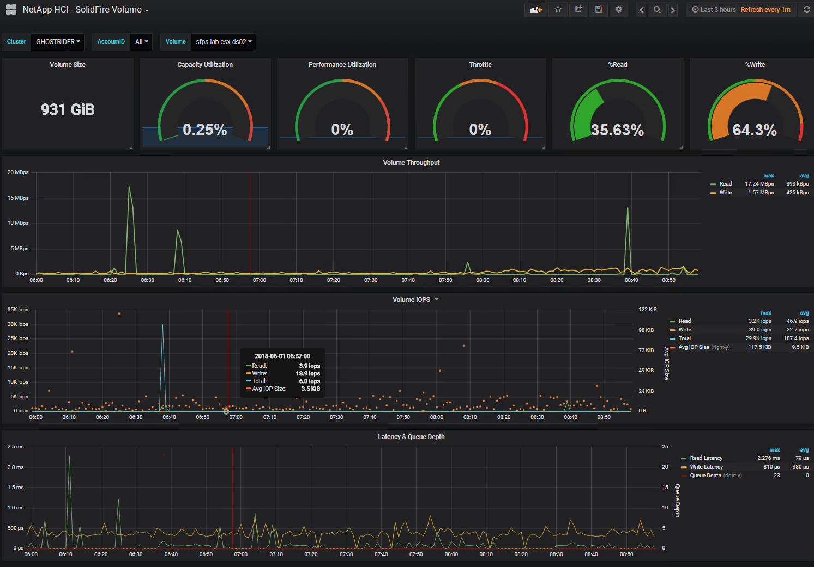
Dashboards
NetApp HCI – SolidFire Volume
Overview of SolidFire volumes
Size
Utilization
Throttle (QoS)
Read:write ratio
Throughput
IOPS
Queue Depth
Latency

Slide 17
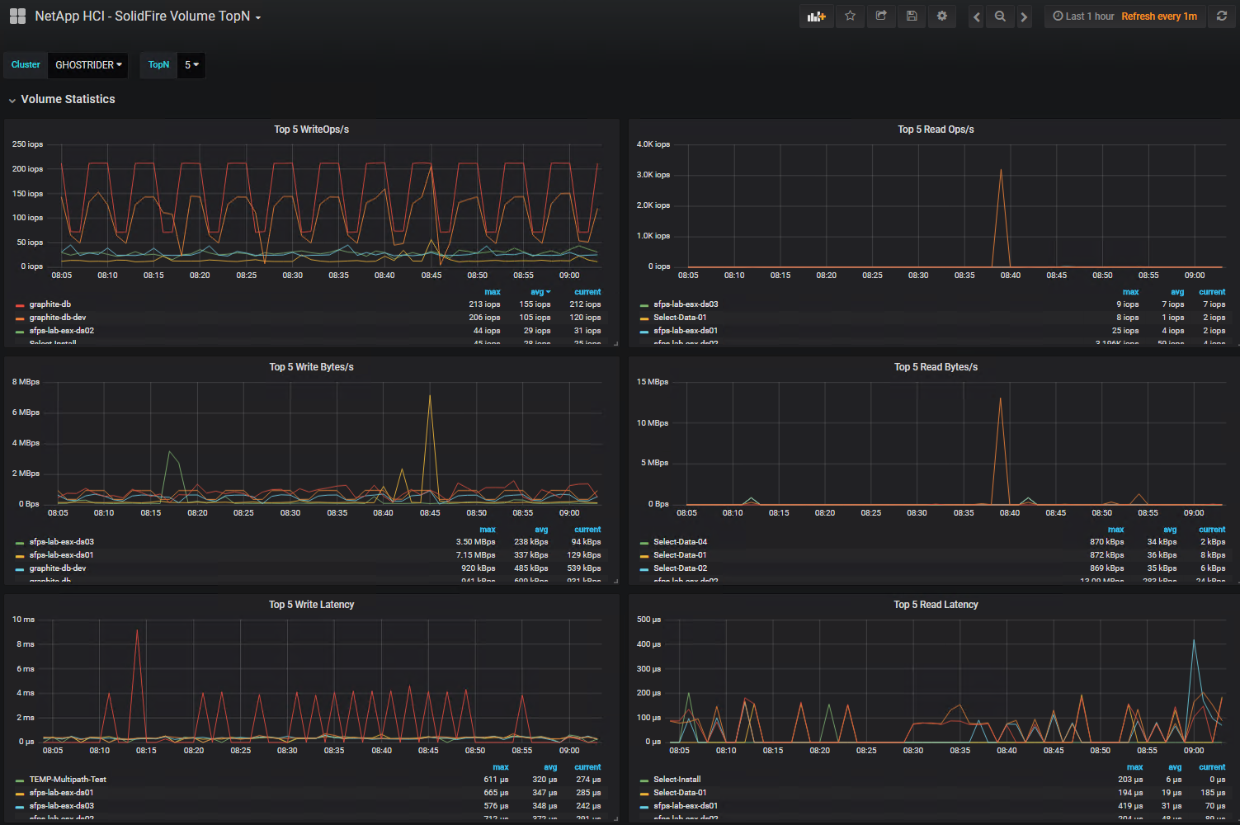
Dashboards
NetApp HCI – SolidFire Volume TopN
Highest utilization volumes
IOPS
Throughput
Latency
Configurable TopN volumes
Sort by
Maximum
Average
Current

Slide 18
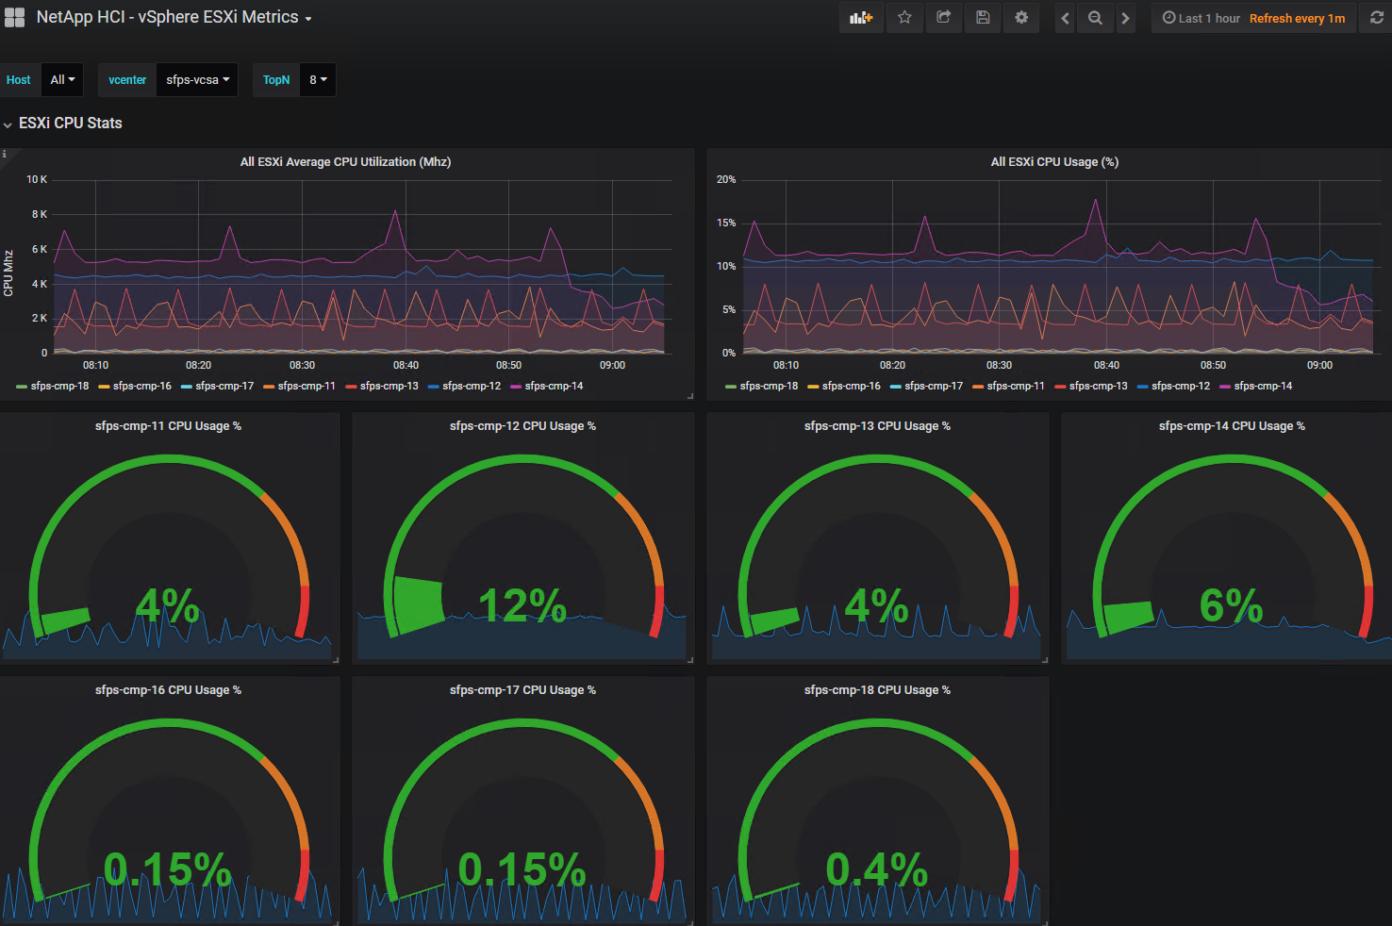
Dashboards
NetApp HCI – vSphere ESXi Metrics
ESXi host overview
CPU utilization (Mhz and %)
Active and total memory usage

Slide 19
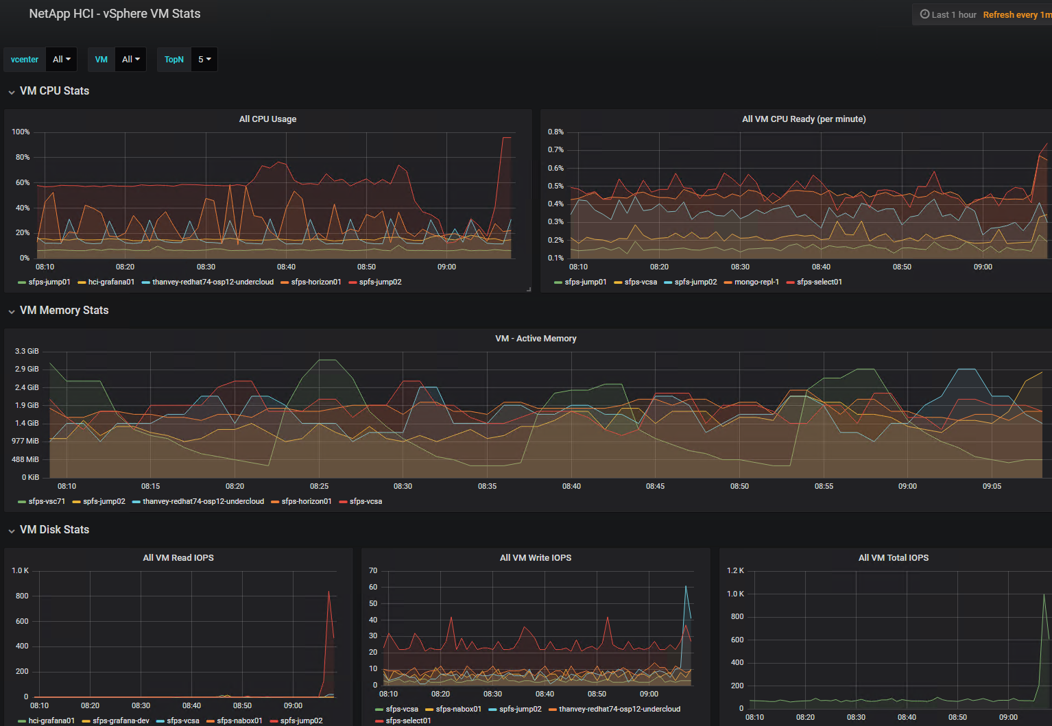
Dashboards
NetApp HCI – vSphere VM Metrics
VM Overview
CPU usage and %Rready
Active Memory
IOPS

Slide 20
Collateral
This presentation
TR-4694-0618-Visualizing-NetApp-HCI-Performance
Demo Video
Notes:
TR-4694 can be downloaded from the following locations:
https://www.netapp.com/us/media/tr-4694.pdf
https://fieldportal.netapp.com/content/729712
Overview PPTX:
https://netapp-my.sharepoint.com/:p:/p/apatten/EeaBqGWmMFBHrk8u4XhegzUBsDelmYn-iBXJuXEorHLQpQ?e=gxnbrD
Demo:
https://netapp-my.sharepoint.com/:v:/p/apatten/EWTuqbEfoS5Ns9Sa7KnGsCABvdU5EMR9DOx99j1DqNFxIg?e=DpMQ21

Slide 21
Thank You

